Slide 1
Welcome to the world of HHR Digital Media Presentation.

Slide 2
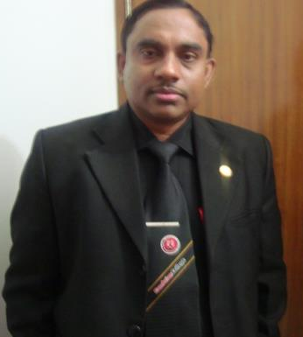
Conducted by-
Md Hasan Hafizur Rahman
Lecturer, English
Cambrian School & College, Campus-05, Dhaka.
Class-9
English First Paper
Writing Part

Slide 3
Let us follow

Slide 4
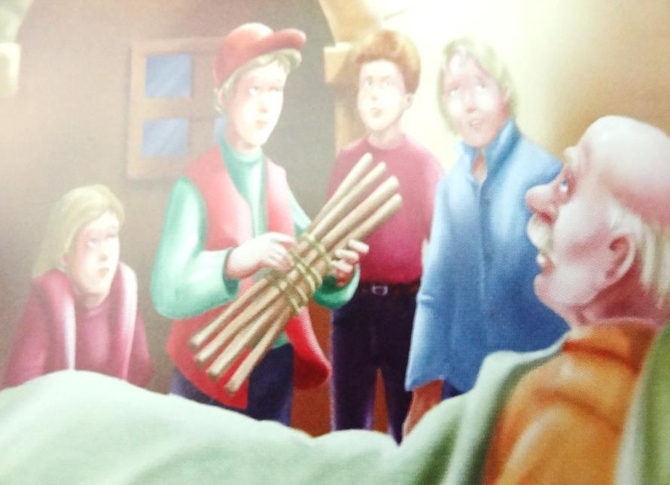
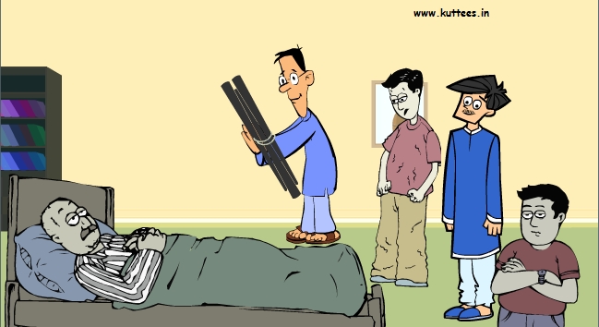

Slide 5
Our today’s lesson is a story and it is on-
Unity is strength

Slide 6
Learning outcomes
After we have studied this lesson we will be able to-
listen information
ask and answer questions
write a story.

Slide 7
Let us enjoy a video

Slide 8
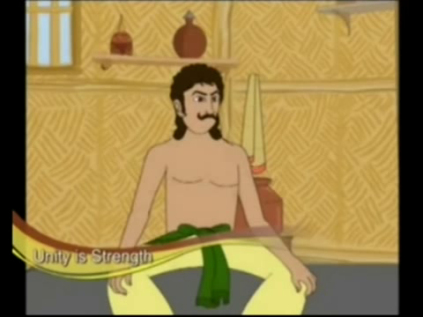
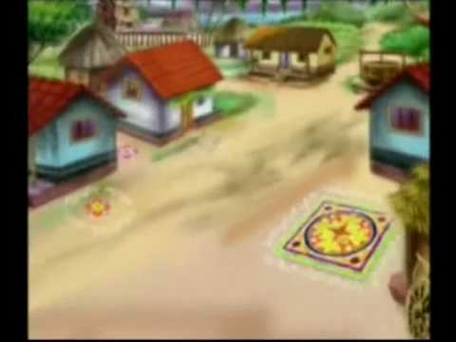
Once there lived a farmer in a village.

Slide 9
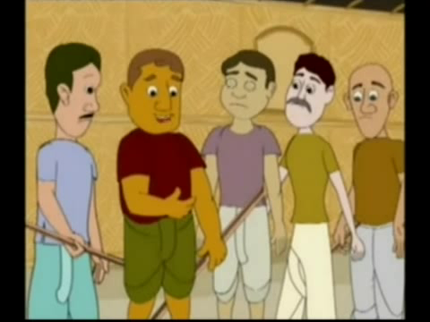
He had five sons.

Slide 10
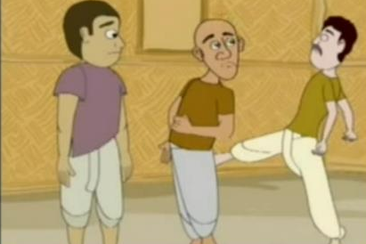
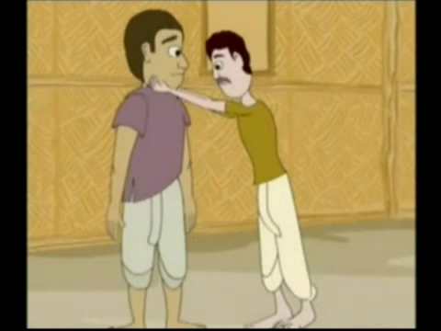
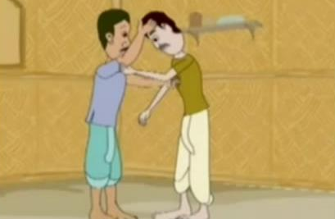
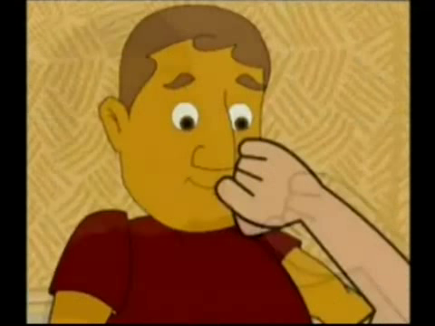
They used to quarrel each other.

Slide 11
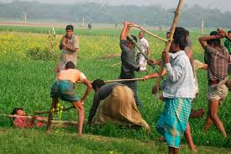
There were jealousy, ill-feelings and enmity among them.

Slide 12
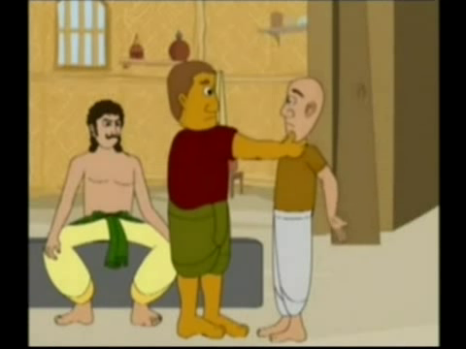
They started quarrelling with a little pretext.

Slide 13
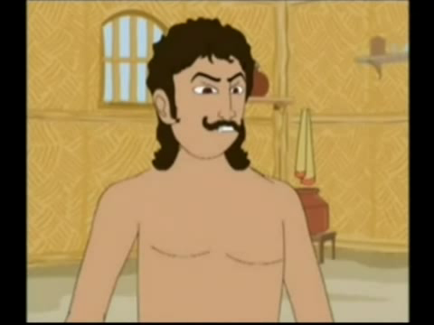
So there was no peace in their family.

Slide 14
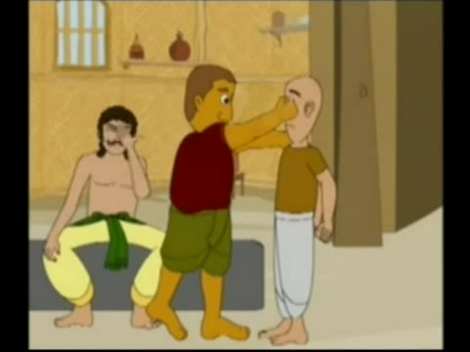
This made the farmer very worried.

Slide 15
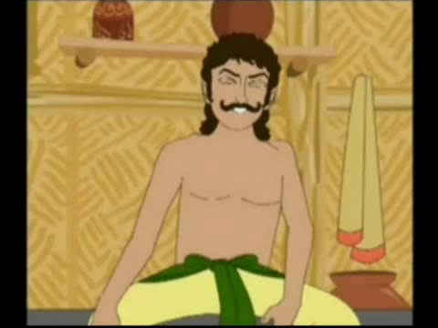
He thought to do something.

Slide 16
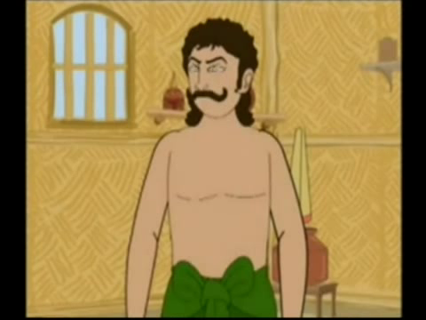
He wanted to teach them a good lesson.

Slide 17
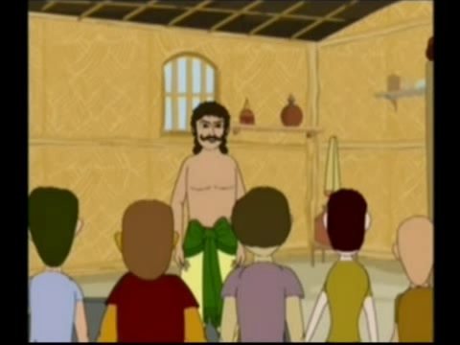
One day he called his sons.

Slide 18
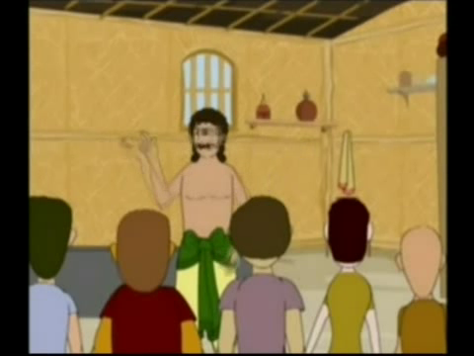
They all came. The farmer told them to bring some sticks and ropes.

Slide 19
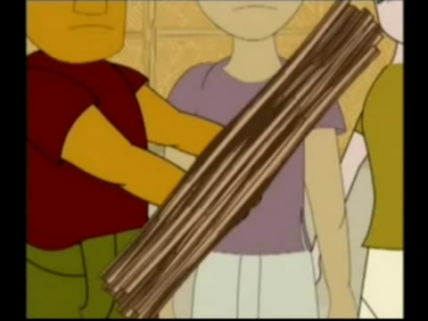
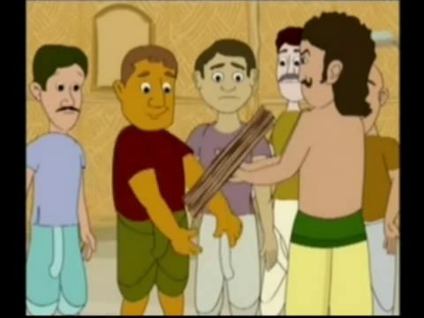
They brought some sticks and ropes and gave it to their father.

Slide 20
He tied the sticks in a bundle and gave it to his sons to break.

Slide 21
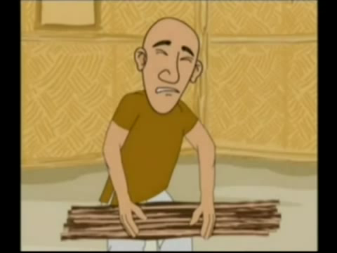
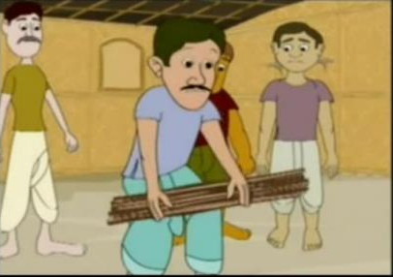
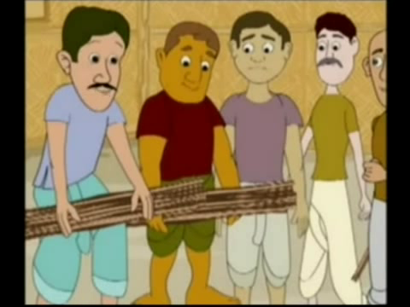
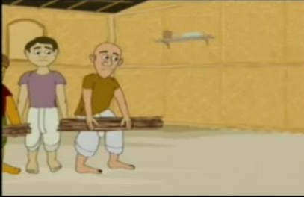
They all tried to break the bundle time and again but failed.

Slide 22
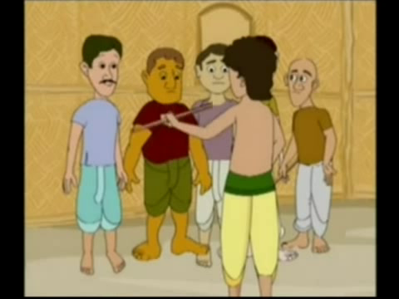
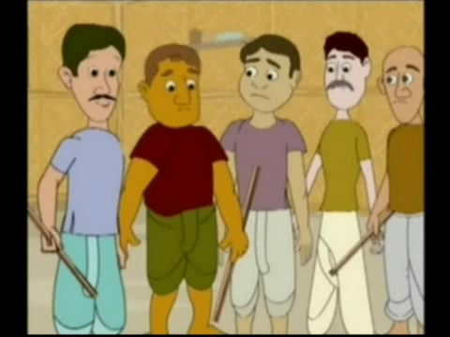
Then the farmer untied the bundle and gave a single stick to each of his sons to break.

Slide 23
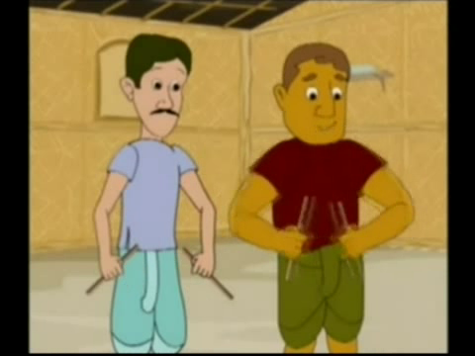
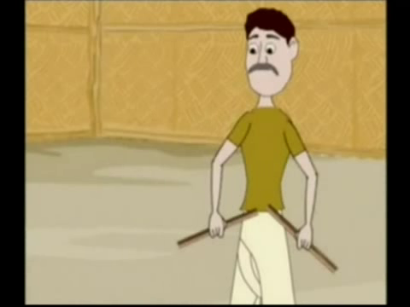
They all broke the sticks very easily.

Slide 24
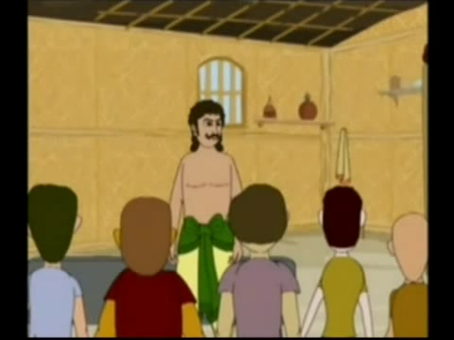
Then the farmer told them that if you are divided like the single sticks, people will break you like the sticks and if you are united, no one will do any harm to you.

Slide 25
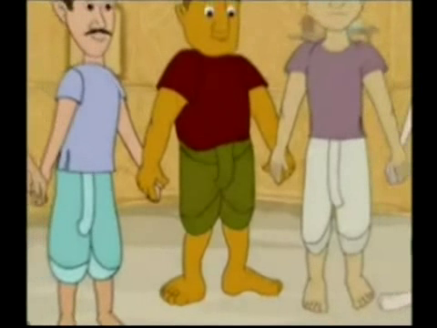
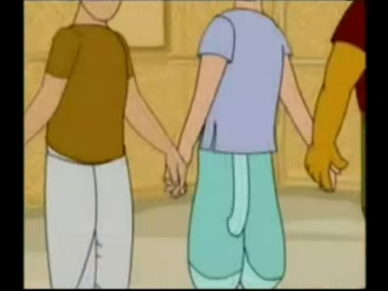
His sons realized their mistakes and became united.

Slide 26



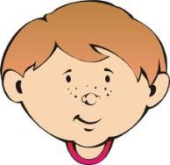
Group Work

Slide 27
Evaluation
Answer the following questions
What is the story about?
How were the sons of the farmer?
What did they do very often?
Why was the farmer worried?
Why did he call his sons?
What is the moral of the story?

Slide 28
Universal
“United we stand
Divided we fall”

Slide 29
Thank You

